Slide 1
EART 28202 : Structural Geology
Class 8 : Contractional Tectonic Regimes
Notes:
In the notes panes to these slides there are numerous references (figure credits and further reading). If the reference is incomplete it refers to the references stated in the reading list on the last slide
With regard to figures in this PowerPoint file, many will be subject to copyright restrictions. I don’t care about you using any of the figures/photos that are mine (Steve Covey-Crump), although a credit would be nice, but take care to comply with copyright restrictions if you reuse any that are not

Slide 2
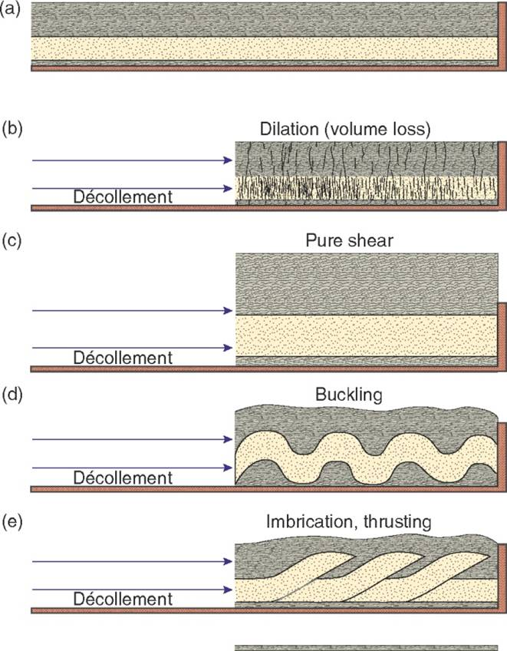
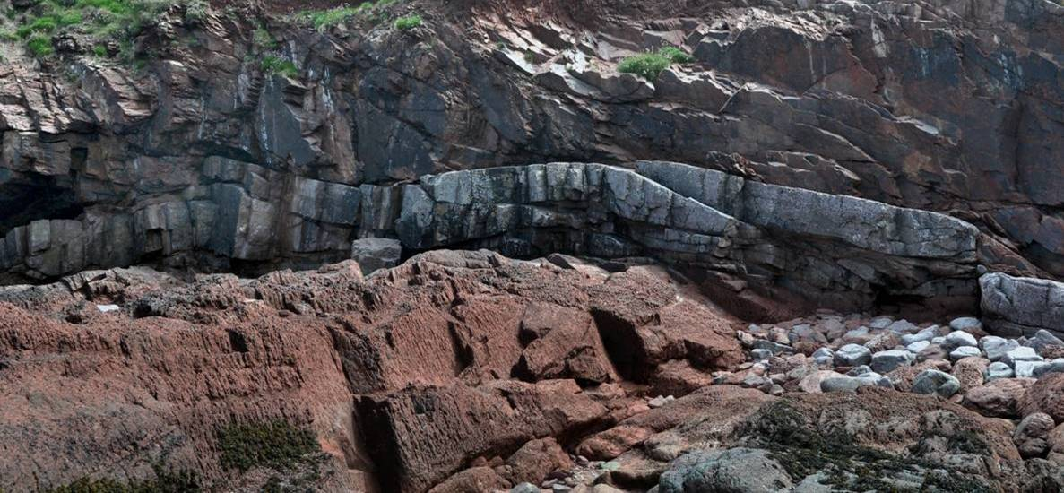
Contractional tectonic regimes
In contractional tectonic regimes shortening is achieved by some combination of
Volume loss (pressure solution/compaction)
Pure shear (horizontal shortening with accompanying vertical thickening)
Buckling
Movement on contractional faults with folding related to that movement
The essential features of the first three of these have been already been covered; this class focuses on number 4
Notes:
Pressure solution as a deformation process is described in the optional PowerPoint presentation on Rock Deformation Mechanisms, pure shear was described in Class 3 (Strain), and buckling in Class 2 (How Folds Form). In a crude sense, one may think of the first three shortening mechanisms simply as ways of accommodating movement on thrust faults. From this perspective, when one sees a fold the question to ask is ‘Where is the fault that led to its formation?’ If you start to think along these lines whenever you are looking at structures in the field, you will automatically find yourself a long way down the path of integrating the structures with the regional geology
Figure right from Fossen, p.356
Photo (Steve Covey-Crump): a Devonian sandstone unit that has been shortened by the formation of thrusts, St. Brides Haven, St. Brides, Pembrokeshire. Note the associated fault-bend folding (fault-bend folds are described on Slide 31)

Slide 3
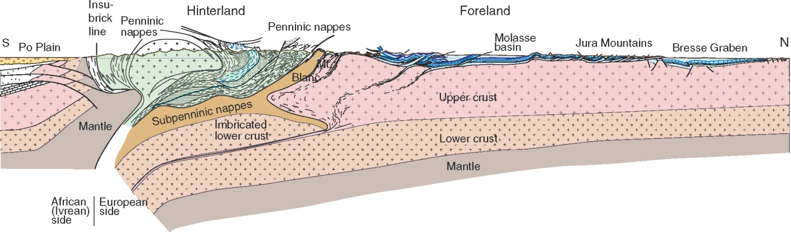
Thin-skinned and thick-skinned tectonics
Although the basic geometry of contractional fault systems was established over 100 yr ago, the subject was set on a much more systematic footing in the 1980s when it was realized that the bulk of the shortening in contractional orogenic belts is localized on to thrust faults
In the foreland these thrust systems are typically restricted to the cover rocks (the basement is not involved), and so the style of deformation is described as thin-skinned
In the higher metamorphic grade hinterland, the thrust systems are thicker and the basement is involved, and so this style of deformation is described as thick-skinned
A section across the Alps
Notes:
Figure (from Fossen, p.362) showing a simplified cross-section across the Alpine orogenic belt

Slide 4
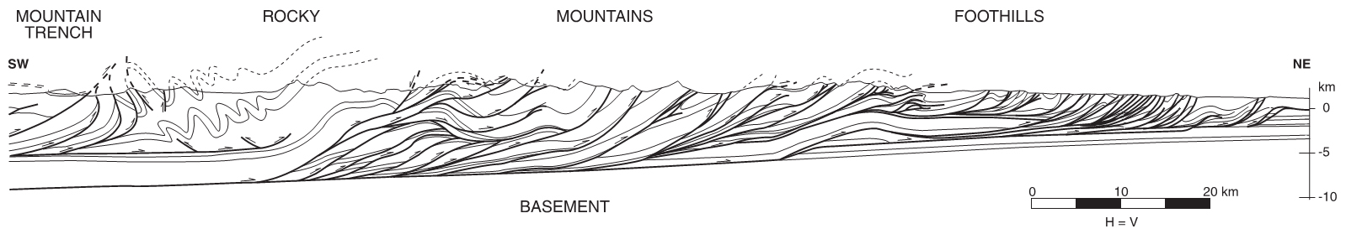
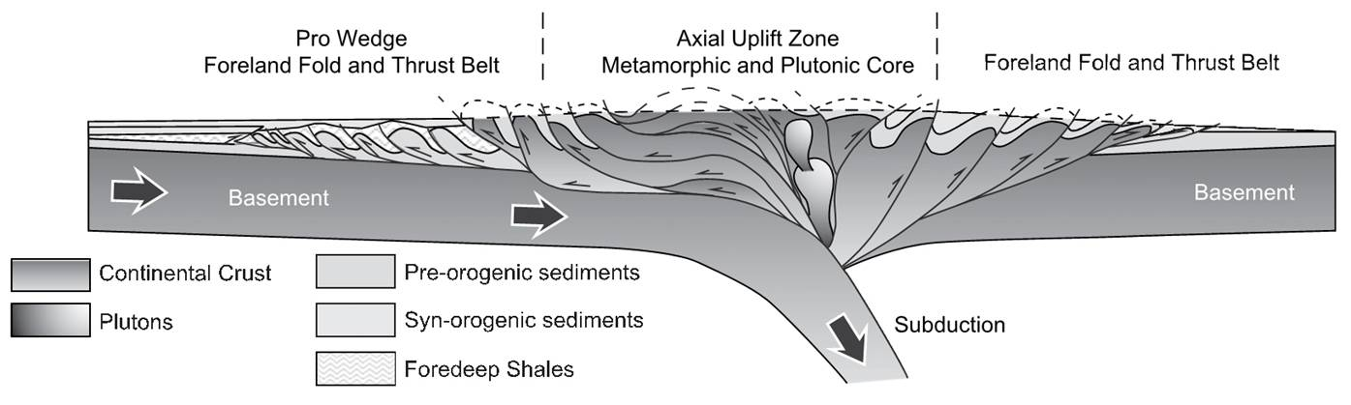
Thrust system interpretations of orogenic belts
Above: cross section across the Rocky Mountains
Left: conceptual model of a doubly-vergent orogenic belt produced in a continent-continent collision. This looks much like a schematic version of a N-S section across the Pyrenees (Spain left; France right)
Once the explanatory power of the thrust system interpretation of contractional orogenic belts was appreciated there was an exciting period in structural geology when orogenic belts all around the world were re-analysed
Notes:
When orogenic belts were re-analysed in this way it was frequently found that the existing geological maps were of such high quality that the maps themselves needed no modification – only the structural interpretation changed (Bailey’s map of the Loch Leven area that those going on the Easter field course will visit is a case in point). This provides a reminder of the importance of separating data (results) from interpretation
Figure top from Poblet & Lisle, 2011, Geological Society, London, Special Publications 349: 1-24, https://doi.org/10.1144/SP349.1
Figure bottom from Duerto & McClay, 2009, Marine and Petroleum Geology 26: 1051-1069, https://doi.org/10.1016/j.marpetgeo.2008.07.004

Slide 5
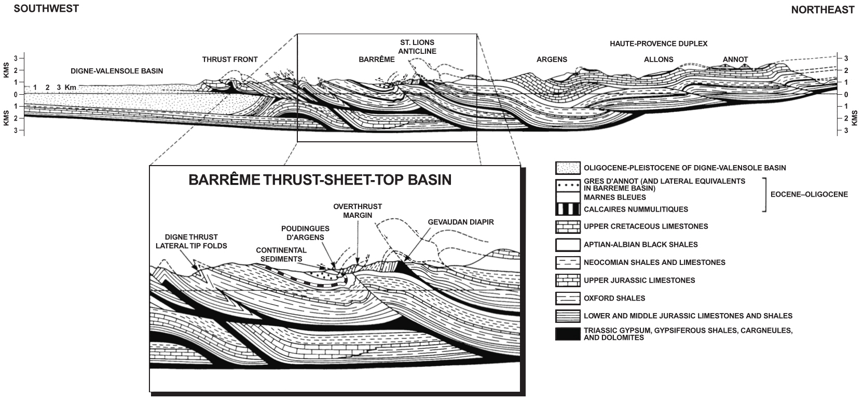
Thrust system interpretations (2) – Barrême
Thrust system interpretation of the region around Barrême, SE France. The thrusts verge to the SW, that is, the dominant transport direction is from right to left on this figure
Notes:
Figure from Evans & Elliott, 1999, Geological Society of America Bulletin 111: 1617-1643, https://doi.org/10.1130/0016-7606(1999)111<1617:EOATST>2.3.CO;2

Slide 6
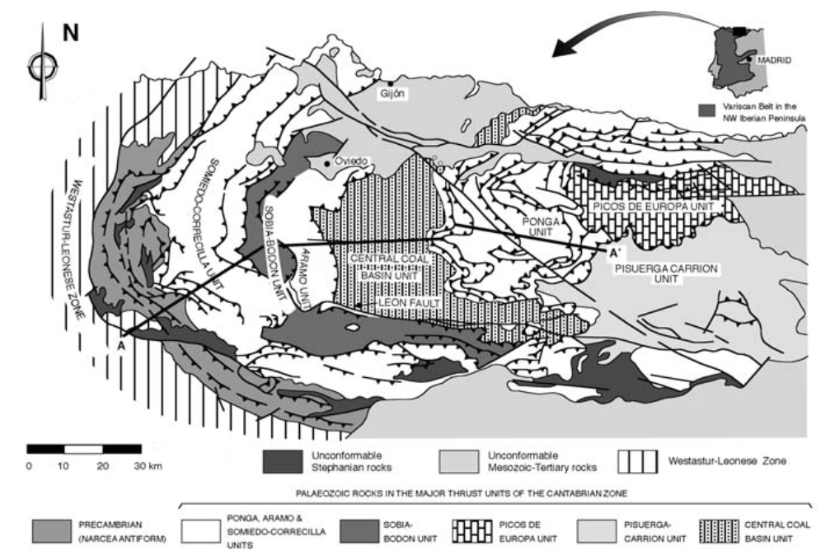
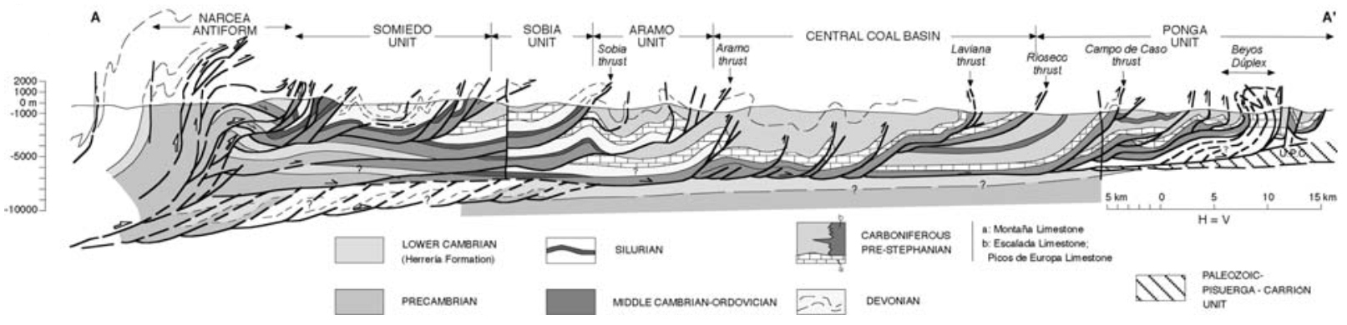
Thrust system interpretations (3) – NW Spain
Thrust system interpretation of the Cantabrian mountains and adjacent areas. The dominant transport direction is from left to right on this figure
Notes:
Map and section from Poblet & Lisle, 2011, Geological Society, London, Special Publications 349: 1-24, https://doi.org/10.1144/SP349.1

Slide 7
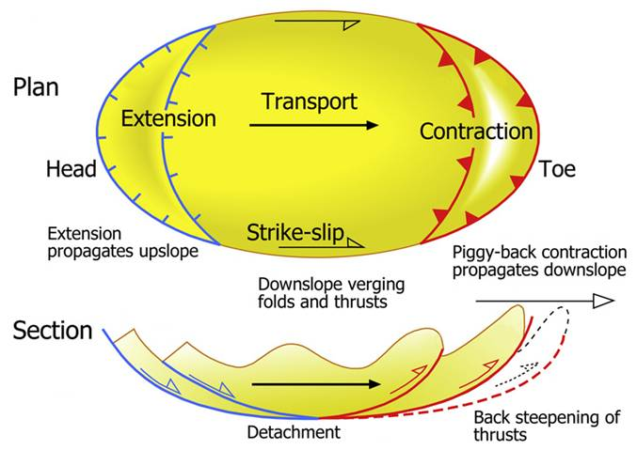
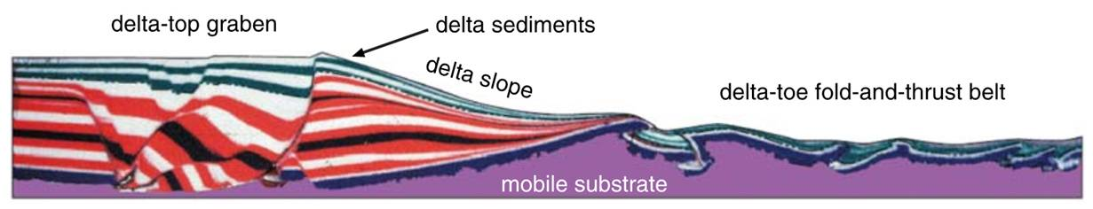
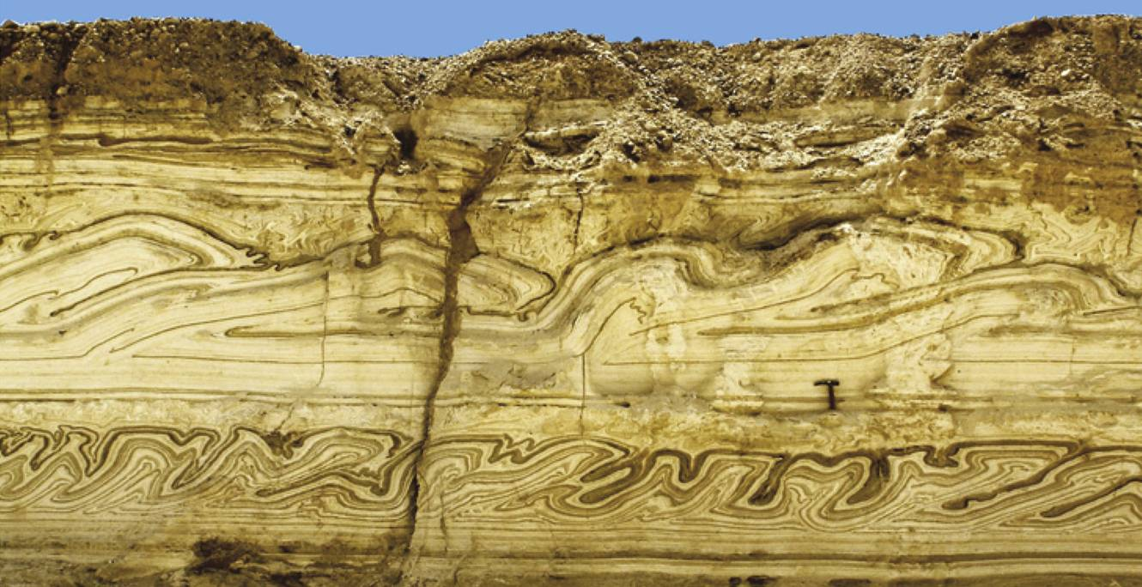
Local contractional regimes
Contractional fault systems with similar geometrical features occur at all scales, and not just at the scale of the orogenic belt
E.g., thrust fault systems may be found at the toe of a landslip or at the toe of a delta slope or within other gravity-driven soft sediment deformation scenarios
Notes:
A beautifully illustrated description of thrust-related, soft-sediment deformation is given by Alsop & Marco, 2011, Journal of Structural Geology 33: 433-457, https://doi.org/10.1016/j.jsg.2011.02.003. Detailed comparisons of the geometry of thrust-related structures in unlithified and lithified successions are given by Alsop et al., 2017, Journal of Structural Geology 94: 98-115, https://doi.org/10.1016/j.jsg.2016.11.008
Many other contractional scenarios, such as the deformation around the margins of diapiric structures or in fault bends, could be added here. Examples could be given down to the scale of the thin section
Figure top left (from Poblet & Lisle, 2011, Geological Society, London, Special Publications 349: 1-24, https://doi.org/10.1144/SP349.1, but deriving from McClay et al., 2000, American Association of Petroleum Geologists Bulletin 84: 765-786, https://doi.org/10.1306/A96733EC-1738-11D7-8645000102C1865D): experimental sand-box model designed to simulate deformation within a delta system that is prograding over a mobile substrate. The weight of the sediments on top of the mobile substrate (in the real world, typically, over-pressured mudstones) drives folding and thrusting in the toe of the delta. The Niger delta is a particularly well-documented example. For further details, see McClay et al., 2003, Geological Society of London Special Publications 216: 411-428, https://doi.org/10.1144/GSL.SP.2003.216.01.27
Figure top right from Alsop & Marco, 2011, Journal of Structural Geology 33: 433-457, https://doi.org/10.1016/j.jsg.2011.02.003
Photo bottom right (from Alsop & Marco, 2011, Journal of Structural Geology 33: 433-457, https://doi.org/10.1016/j.jsg.2011.02.003): seismogenic slumps in the Dead Sea basin

Slide 8
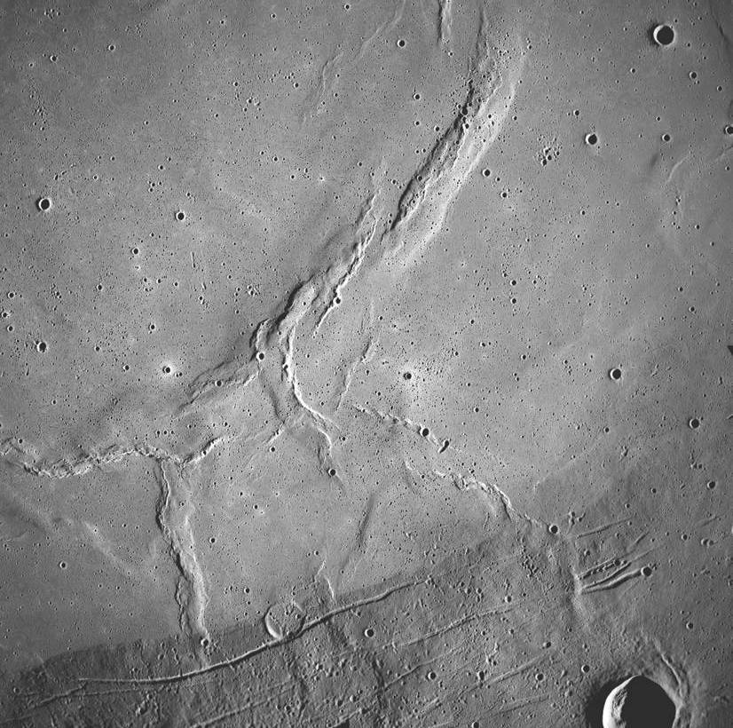
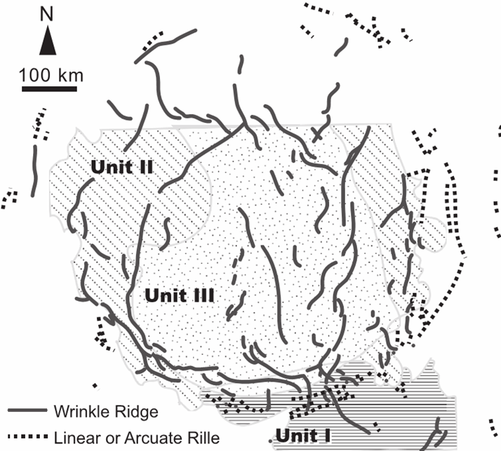
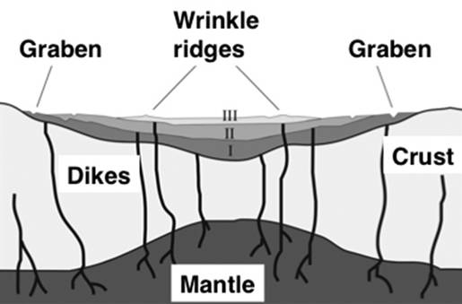
Wrinkle ridges (local contraction) on the Moon
“Local” contractional features (wrinkle ridges) occur on the Moon within the interior of mare and are accompanied by extensional fractures (rilles) around the mare margins
These fractures were formed during basin-localized flexure of the lunar crust under the weight of the mare basalts
Mare Serenitatis
Notes:
For a discussion of lunar wrinkle ridges within mare interiors, see Solomon & Head, 1980, Reviews in Geophysics 18: 107-141, https://doi.org/10.1029/RG018i001p00107. The interpretation of how they form has some complexity in the details – see Freed et al., 2001, Journal of Geophysical Research 106: 20603-20620, https://doi.org/10.1029/2000JE001347. For a detailed account, see Watters & Schultz (editors), 2010, Planetary Tectonics, Chapter 4. For an example of the analysis of lunar wrinkle ridges, and in particular of the relationship between the maximum height of these ridges and their length, see Li et al., 2018, Journal of Structural Geology 109: 27-37, https://doi.org/10.1016/j.jsg.2018.01.003 – that study makes use of the kind of fault displacement vs. length relationships that were noted in Class 7 Slide 38
Image top right (from www.lpi.usra.edu/resources/apollo/frame/?AS17-M-0451): Apollo 17 image of the south-eastern part of Mare Serenitatis showing wrinkle ridges and rilles
Figure left (from Yamaji, 2007, An Introduction to Tectonophysics: Theoretical Aspects of Structural Geology, p.201): map of the whole of Mare Serenitatis showing the distribution of wrinkle ridges and rilles
Figure right (by Hiesinger – http://www.nasa.gov/mission_pages/LRO/news/lro-20100428-tranquilitatis.html): schematic diagram showing the marginal tensile stresses and interior compressive stresses that are set up during flexural subsidence of lunar crust under the weight of a composite mare basalt sequence (units I, II, III)

Slide 9
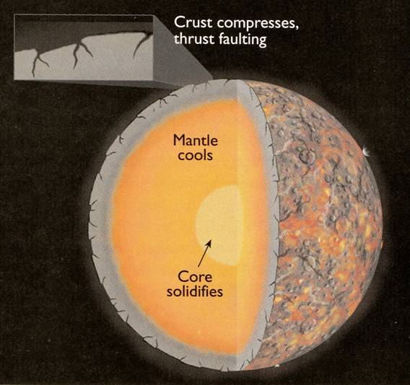
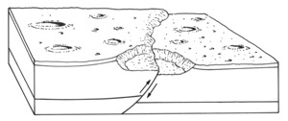
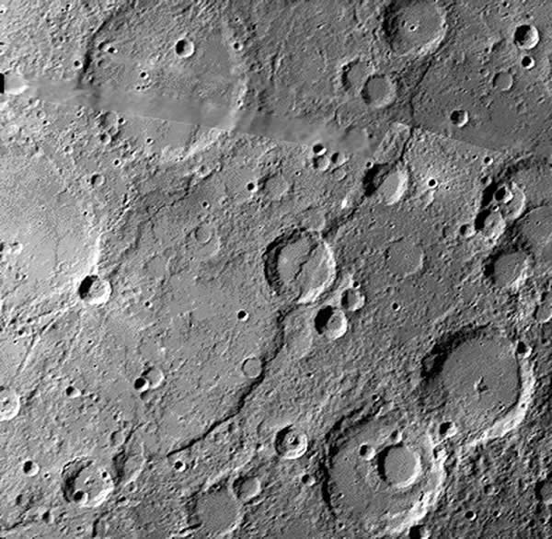
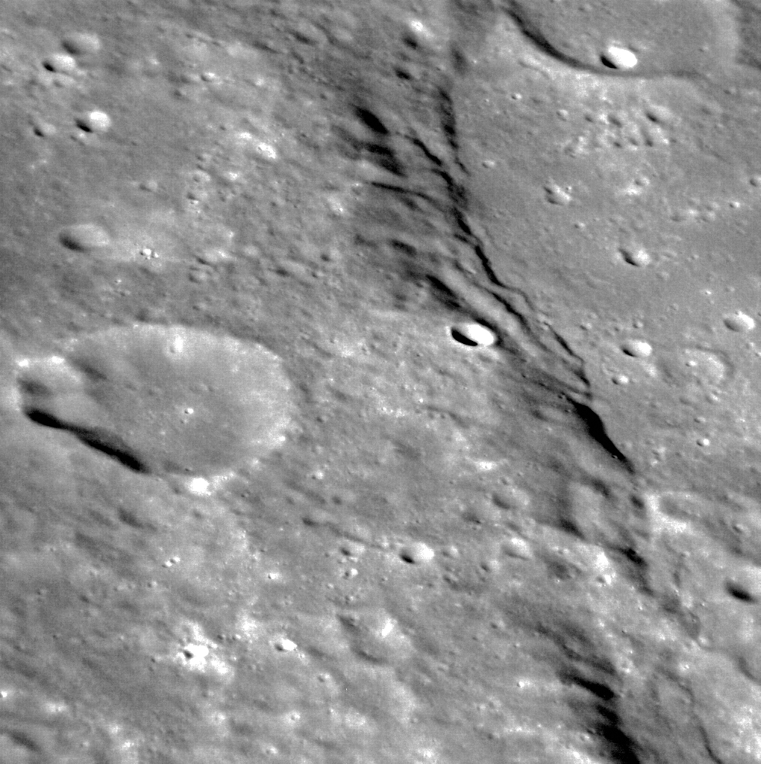
Lobate scarps produced by global contraction
Global distributions of lobate scarps are common on many planetary bodies and reflect global contraction due to net cooling of the planetary interior
Analysis of the geometry of these features indicates that they are the surface expression of antiforms formed above the tips of reverse faults that break the surface
Left: Discovery Rupes, which at 500 km+, is the longest lobate scarp on Mercury
Right: detail of a lobate scarp in the northern hemisphere of Mercury
Notes:
For features produced by global contraction, see: Mercury – Watters et al., 2009, Earth & Planetary Science Letters 285: 309-319, https://doi.org/10.1016/j.epsl.2009.03.040; Moon – Watters et al., 2010, Science 329: 936-940, https://doi.org/10.1126/science.1189590; Mars – Nahm & Schultz, 2011, Icarus 211: 389-400, https://doi.org/10.1016/j.icarus.2010.11.003
For fault analyses of these contractional features, see Schultz, 2000, Journal of Geophysical Research 105: 12035-12052, https://doi.org/10.1029/1999JE001212; Galluzzi et al., 2015, Geological Society, London, Special Publications 401: 313-325, https://doi.org/10.1144/SP401.17. A particularly well studied contractional fault system on Mercury is Beagle Rupes (see Rothery & Massironi, 2010, Icarus 209: 256-261, https://doi.org/10.1016/j.icarus.2009.12.009)
On the surface of the Moon, over 3200 lobate scarps have been mapped and interpreted as the surface expression of thrust faulting. These are distinguished from wrinkle ridges (see previous slide) which are more complex contractional features. The lobate scarps occur predominantly in the lunar highlands and are relatively young features (< 50 Ma) – some may be actively forming today. Their global distribution suggests that tidal stresses, superimposed on global contraction, play a part in their formation (see Watters et al., 2015, Geology 43: 851-854, https://doi.org/10.1130/G37120.1)
Figure top right from Beatty et al. (editors), 1999, The New Solar System (4th edition), p.93
Figure centre top from http://www.explanet.info/Chapter05.htm
Image left from http://airandspace.si.edu/research/ceps/etp/mercury/mercimg/discovery_rupes.jpg
Image right from www.nasa.gov/images/content/629356main_messenger_orbit_image20120312_1_full_full.jpg

Slide 10

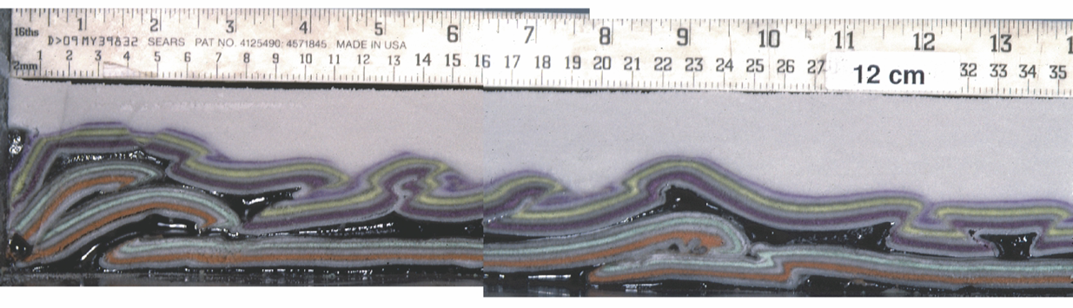
Developing our understanding of thrust systems
Most of our understanding of the geometry of thrust systems and the factors that influence how they develop comes from careful field observations, but an important contribution has also been made by physical modelling using carefully scaled analogue materials
(and also, numerical models)
Notes:
For a historical review of approaches to analogue modelling of contractional tectonic structures, see Graveleau et al., 2012, Tectonophysics 538-540: 1-66, https://doi.org/10.1016/j.tecto.2012.01.027. Twiss & Moores (Chapter 18) provide an introductory account of scaling issues that arise in such modelling. A commentary on the reliability of analogue models of contractional tectonic structures is given by Schreurs et al., 2016, Journal of Structural Geology 92: 116-139, https://doi.org/10.1016/j.jsg.2016.03.005
The development of contractional tectonic structures can also be modelled numerically. A comparison of numerical models that were designed to mimic particular analogue experiments is given by Buiter et al., 2016, Journal of Structural Geology 92: 140-177, https://doi.org/10.1016/j.jsg.2016.03.003
Photo top (from Fossen (1st edition), p.11): clay experiments performed by Henry Cadell in 1887 to illustrate the formation of the structures then being mapped for the first time in the north-western Scottish Highlands. For a description of Cadell’s experiments and an assessment of some of their strengths and limitations, see Butler et al., 2020, Geological Society, London, Special Publications 420: 9-31, https://doi.org/10.1144/SP490-2019-142. For a short biography of Cadell, see http://www.edinburghgeolsoc.org/eg_pdfs/issue48_03_articlebymendum.pdf
Photo bottom (from Couzens-Schultz et al., 2003, Journal of Structural Geology 25: 1623-1644, https://doi.org/10.1016/S0191-8141(03)00004-X): results of a quartz sand/viscous silicone polymer model

Slide 11
Terminology

Slide 12
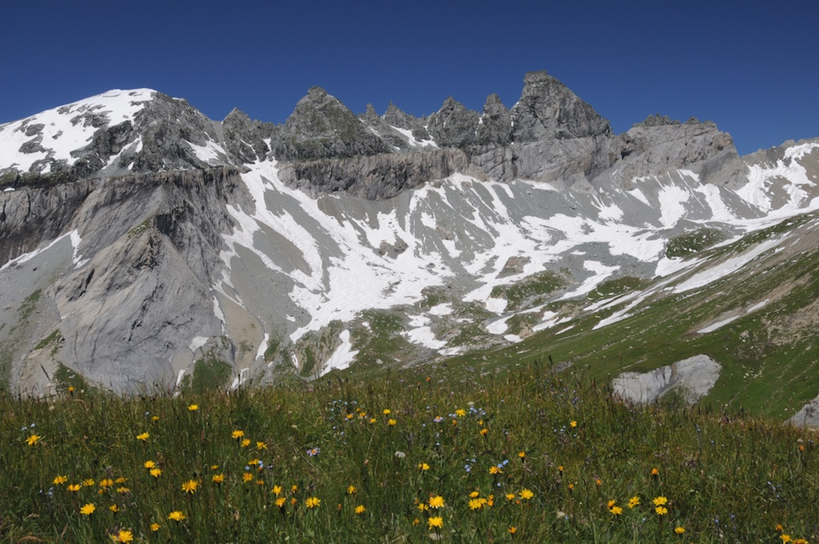
Thrusts
A thrust is a predominantly low angle fault or shear zone with a predominantly reverse dip-slip sense of movement
In rocks that young upwards, thrusts bring older rocks over younger rocks, or if the metamorphic grade decreases upwards, thrusts bring rocks of higher metamorphic grade over rocks of lower metamorphic grade
Thrusts exist at all scales, from those with extents and displacements of millimetres, through to those on the scale of mountain ranges with displacements of 10s or 100s of kilometres
Glarus Thrust in Switzerland
Notes:
Photo (from Fossen, one of the extra figures on the web-site for the book, folk.uib.no/nglhe/StructuralGeoBook.html): the thrust is marked by the thin, sub-horizontal darker band running midway across the rock face

Slide 13
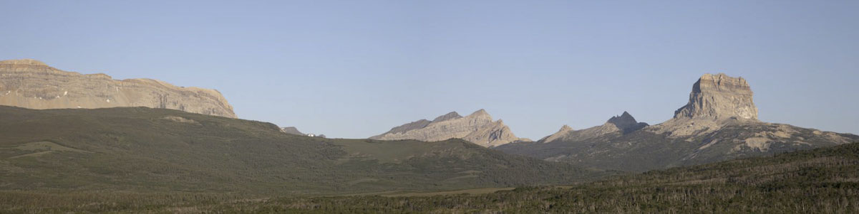
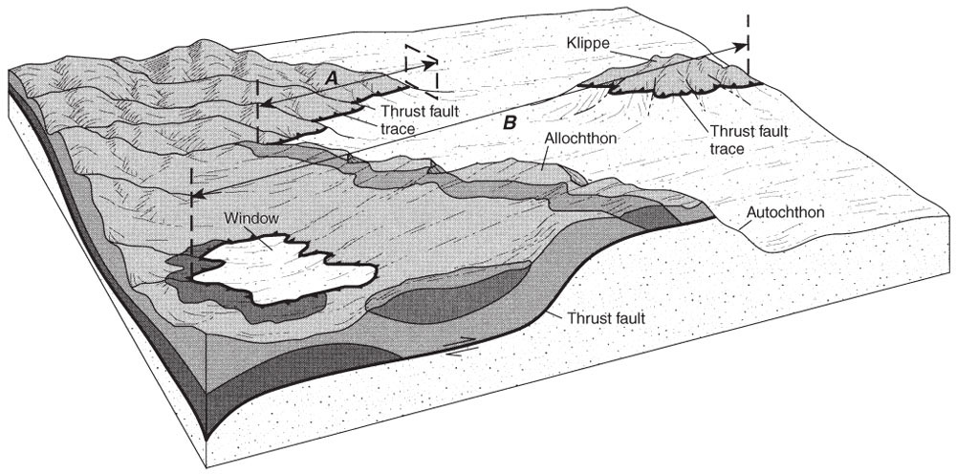
Nappe, klippe/window, allochthon/autochthon
The hanging wall of a low angle, large displacement thrust is wide compared with its thickness and so is described as a thrust nappe or thrust sheet
Erosion through a thrust sheet may mean that it is discontinuously exposed: an erosional remnant of a nappe is a klippe; an erosional hole exposing the units beneath the thrust is a (tectonic) window
Thrust sheet is transported (allochthon);
Footwall is close to its original location (autochthon);
Slices of basement/cover caught up in the thrusting and moved relatively short distances (parautochthon)
Notes:
‘Nappe’ is French for ‘tablecloth’
Photo (from www.marlimillerphoto.com/ChiefMtnPan.html): the Lewis Thrust, Glacier National Park, Montana, in the Rocky Mountains. Chief Mountain on the right is the classic example of a klippe (see Boyer & Elliott, p.1205)
Figure from Twiss & Moores, p.118

Slide 14
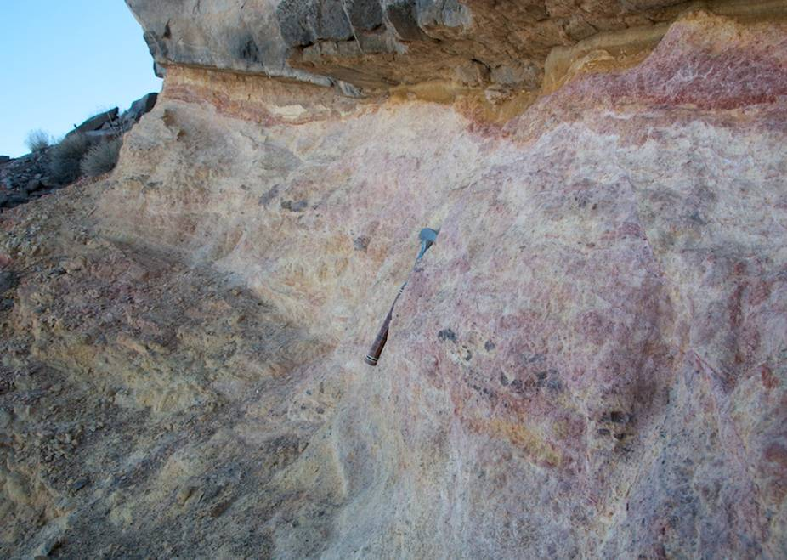
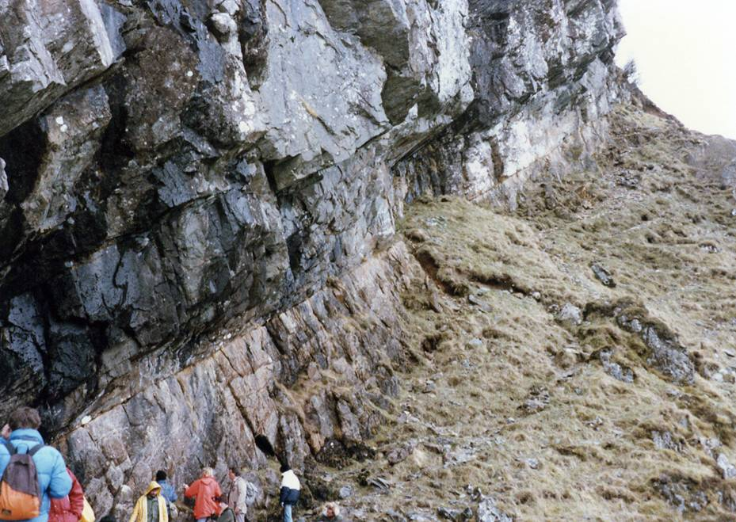
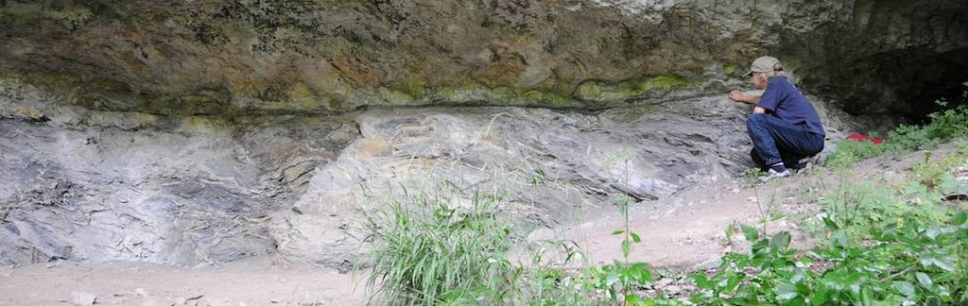
The fault surface
The fault surface on thrusts with large displacements may be remarkably sharp → this is a testament to the efficiency of strain localization once the thrust has formed
Muddy Mountains Thrust (top left), Glencoul Thrust (above) and Glarus Thrust (left)
Notes:
Some care is needed in interpreting this sharpness – the fault surface exposed in the field may just be a fracture formed in the last stage of movement. Nevertheless, it is true that given the large displacements that have occurred on them, thrusts are often remarkably narrow zones of deformation
Photo top left (from Fossen, one of the extra figures on the web-site for the book, folk.uib.no/nglhe/StructuralGeoBook.html): the Muddy Mountains Thrust (SE Nevada, USA) brings Palaeozoic carbonates over Jurassic sandstones
Photo top right (Steve Covey-Crump): the Glencoul Thrust is part of the Moine Thrust Zone in NW Scotland and in the photo brings Precambrian Lewisian gneisses over limestones of Cambrian-Ordovician age. Fossen p.358 shows his version of this photo together with some structural context
Photo bottom (from Fossen, one of the extra figures on the web-site for the book, folk.uib.no/nglhe/StructuralGeoBook.html): the Glarus Thrust (Lochsite, Switzerland) here brings Permian units over Cenozoic flysch

Slide 15
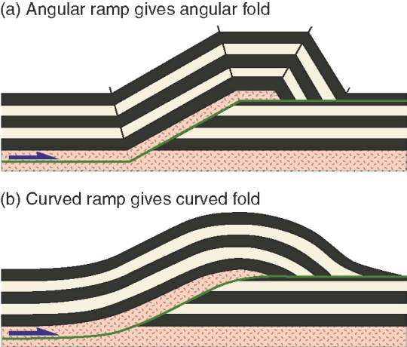
Shape of the thrust surface: ramps/flats
A low angle thrust fault typically passes up stratigraphy in a series of steps in which it alternately follows weak horizons and cuts up section across more competent layers
Where the fault runs parallel to layering it is described as a flat; where it cross-cuts and truncates the layering it is described as a ramp
Note that the position of flats and ramps may differ on footwall and hanging wall
footwall flat
hanging wall flat
footwall ramp
hanging wall flat
footwall flat
hanging wall ramp
Notes:
Figure from Fossen, p.364

Slide 16
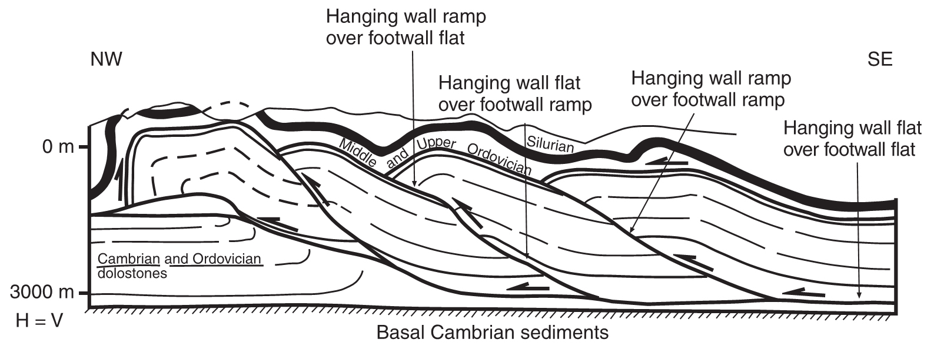
Shape of the thrust surface: ramps/flats 2
A real example from the Nittany anticlinorium, Central Appalachians
Note that for each hanging wall ramp there must be a corresponding footwall ramp
Notes:
Figure from Poblet & Lisle, 2011, Geological Society, London, Special Publications 349: 1-24, https://doi.org/10.1144/SP349.1

Slide 17
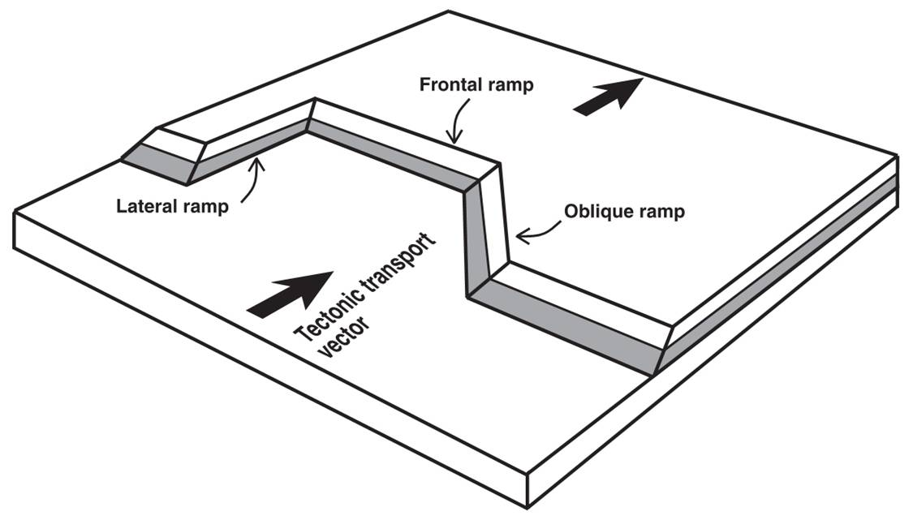
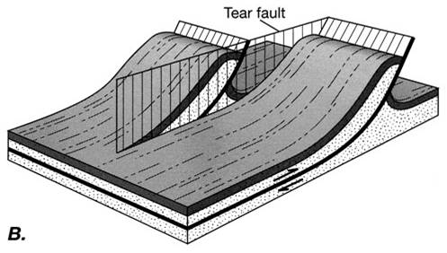
Frontal/oblique/lateral ramps
Ramps that form perpendicular to the main thrust transport direction are frontal ramps. These ramps are pure dip-slip reverse faults
Oblique ramps are oblique to the transport direction and are oblique-slip reverse faults
Lateral ramps are parallel to the movement direction and are strike-slip faults. Effectively, they transfer slip from one frontal ramp on to another and so are described as transfer faults, or, if sub-vertical and cutting through the hanging wall, as tear faults
Notes:
We will return to the ‘transfer fault’ and ‘tear fault’ terminology in the final class (Strike-slip tectonic regimes)
Figure top from Poblet & Lisle, 2011, Geological Society, London, Special Publications 349: 1-24, https://doi.org/10.1144/SP349.1. The hanging wall has been removed to show the shape of the fault surface beneath
Figure bottom from Twiss & Moores, p.124

Slide 18
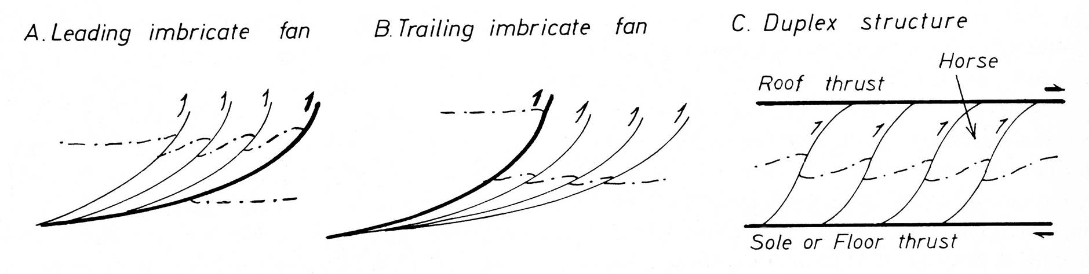
Thrust systems: fault imbrication and duplexes
Thrusts often come as sets of listric faults, each fault with the same sense of slip, so that the individual thrust sheets overlap like a set of roofing tiles. This situation is described as an imbricate fan. Leading imbricate fans have maximum slip on the frontal fault; trailing imbricate fans have maximum slip on the most internal fault
Imbricate faults merge down on to a sole or floor thrust. They may also merge up on to a roof thrust. An imbricate system that is bounded by a floor and a roof thrust is known as a duplex, and the internal blocks (which are bounded completely by faults) as horses
The major floor thrust at the base of a stack of thrust nappes and/or imbricate system is described as a décollement or basal detachment
Notes:
Recall (Class 7 Slide 4) that a listric fault is a (curved) fault that gradually decreases in dip downwards
Figure from Ramsay & Huber, 1987, The Techniques of Modern Structural Geology, Volume 2: Folds and Fractures, p.526

Slide 19
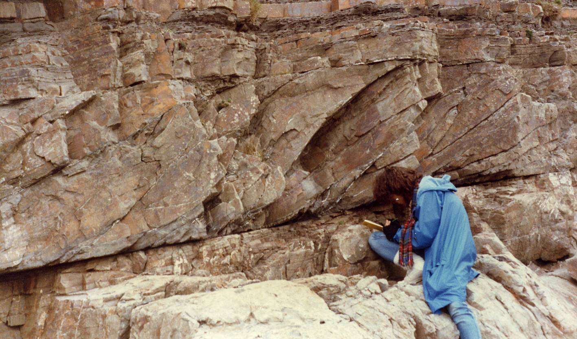
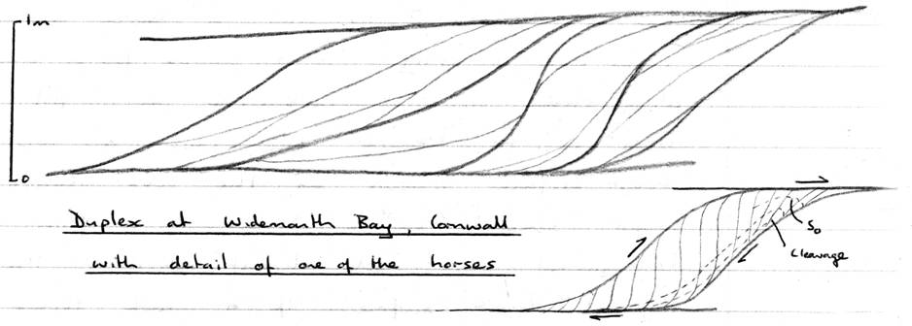
Thrust duplexes
Small-scale thrust duplex at Widemouth Bay, Cornwall, with illustrative field sketch (not the same field of view as the photo)
Roof thrust
Floor thrust
Notes:
Photo (Steve Covey-Crump)
Field sketch (Steve Covey-Crump)

Slide 20
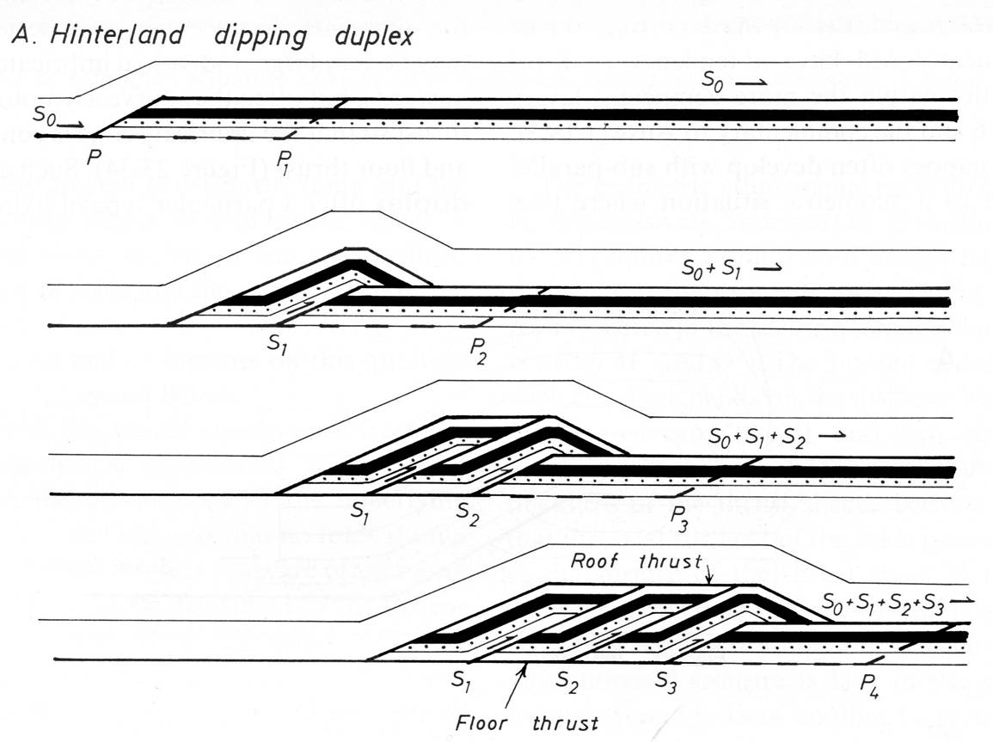
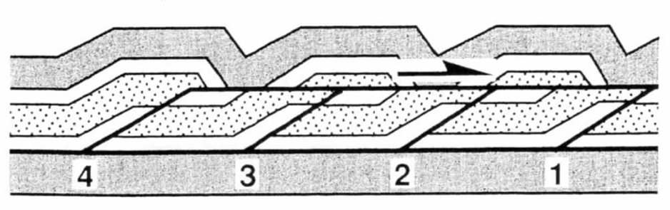
Formation of hinterland-dipping thrust duplexes
Thrust duplexes form sequentially, usually propagating towards the foreland: a horse is formed in the footwall, is displaced forwards, and becomes inactive; a new horse is then formed in the footwall . . .
The ramps bounding the horses dip towards the hinterland
Less commonly, the horses nucleate in the hanging wall so that they propagate towards the hinterland. This is described as a break-back sequence
Notes:
In each figure the horses are formed in the order 1, 2, 3, 4. The movies AntStack.m4v and OOSDuplex.m4v that accompany this lecture show the development of a foreland-propagating and a hinterland-propagating duplex respectively. These movies come from Rick Allmendinger’s website, http://www.geo.cornell.edu/geology/faculty/RWA/movies/ OR look in the videos tab at https://www.rickallmendinger.net/)
Figure top left from Ramsay & Huber, 1987, The Techniques of Modern Structural Geology, Volume 2: Folds and Fractures, p.526
Figure bottom right from McClay, p.431

Slide 21
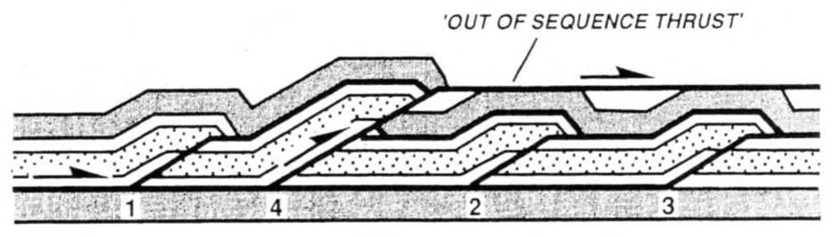
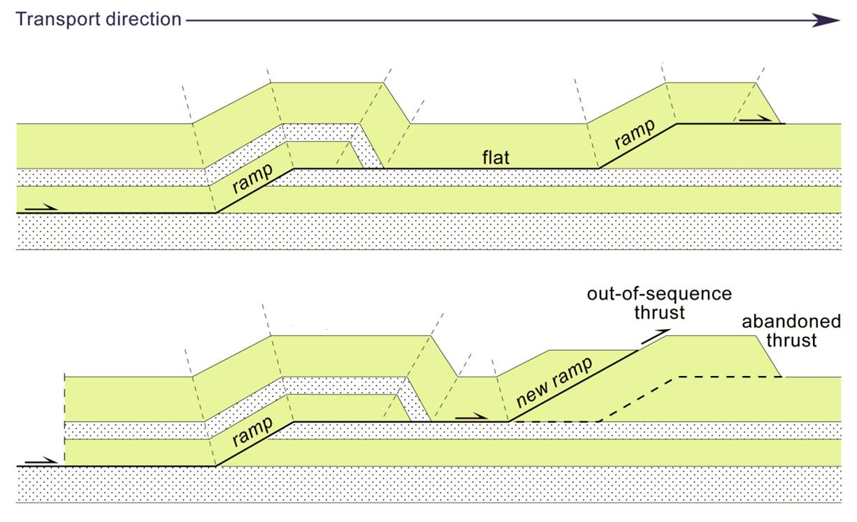
Out-of-sequence thrusts
Although thrusts usually propagate towards the foreland, it is not uncommon for an out-of-sequence thrust to develop at a position behind the thrust front
Such thrusts may be newly initiated faults, or they may reactivate an earlier formed fault
Notes:
Figure top right from McClay, p.431
Figure bottom left from J-P Burg’s 2015 lecture notes (www.files.ethz.ch/structuralgeology/JPB/files/English/4thrustsyst.pdf), p.117

Slide 22
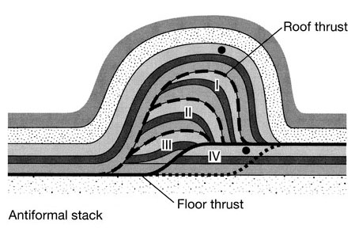
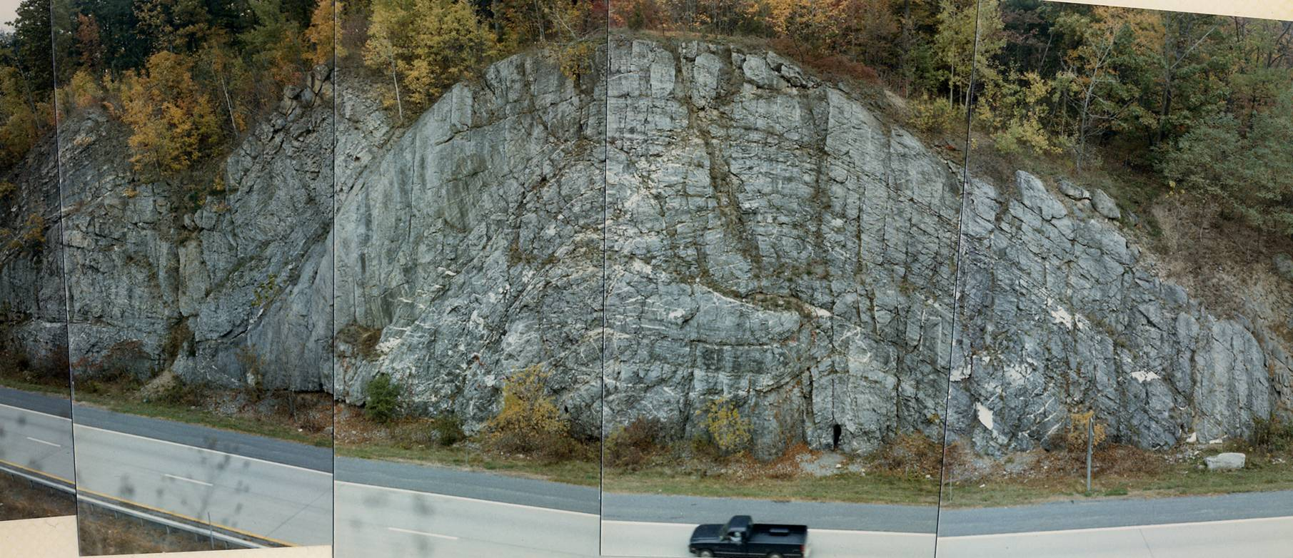
Antiformal stacks
When there is greater drive on the roof thrust than on the floor thrust, foreland-propagating thrust duplexes develop such that the horses are stacked, resulting in an antiform in the overlying thrust sheet
Such structures are described as antiformal stacks
Notes:
Figure top right from Twiss & Moores, p.125
Photo (Steve Covey-Crump): an antiformal stack exposed in a road cut on the north side of Route 23, near Catskill, New York State. For an account of this section, see Pazzaglia (editor), 2006, Excursions in Geology and History: Field Trips in the Middle Atlantic States, Geological Society of America Field Guide 8: 199-216, https://doi.org/10.1130/2006.fld008(10)

Slide 23
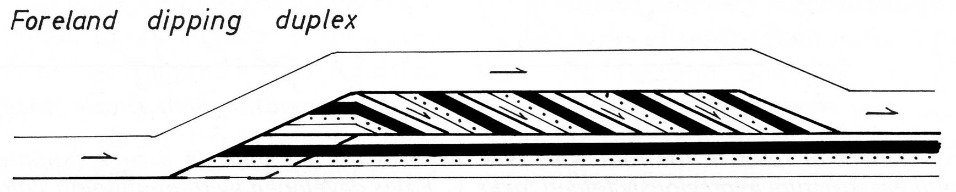
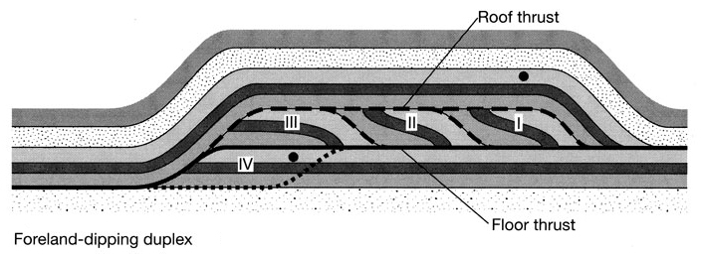
Foreland-dipping thrust duplexes
Less commonly, thrust duplexes develop such that individual horses are added to the back of the duplex and the ramps bounding the horses dip towards the foreland
Notes:
Figure top from Ramsay & Huber, 1987, The Techniques of Modern Structural Geology, Volume 2: Folds and Fractures, p.526
Figure bottom from Twiss & Moores, p.125

Slide 24
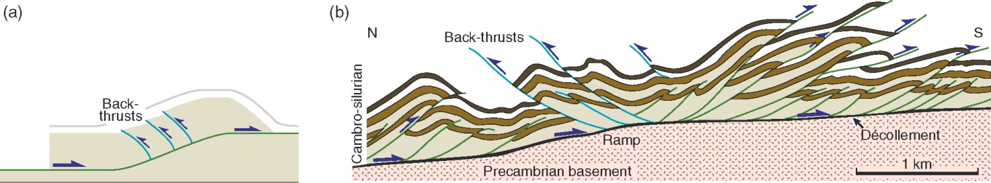
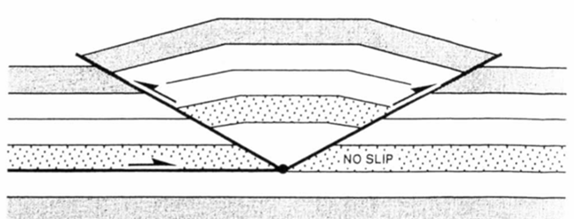
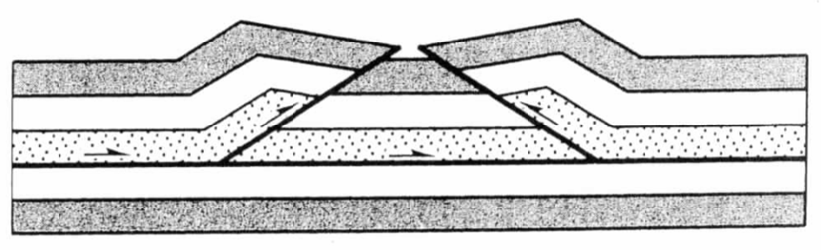
Back thrusts/pop-ups/triangle zones
As thrust sheets climb over ramps, thrusts with the opposite vergence may form (effectively in the conjugate fault orientation). These are back-thrusts
Combinations of thrusts and back-thrusts with the same floor thrust delimit pop-ups (left) and triangle zones (right)
Back thrusts above a ramp in a section from north of Oslo, Norway
triangle zone
pop-up
Notes:
Figure top right from Fossen, p.361
Figure left middle from McClay, p.422
Figure right middle from McClay, p.424
Figure bottom from Fossen, p.361

Slide 25
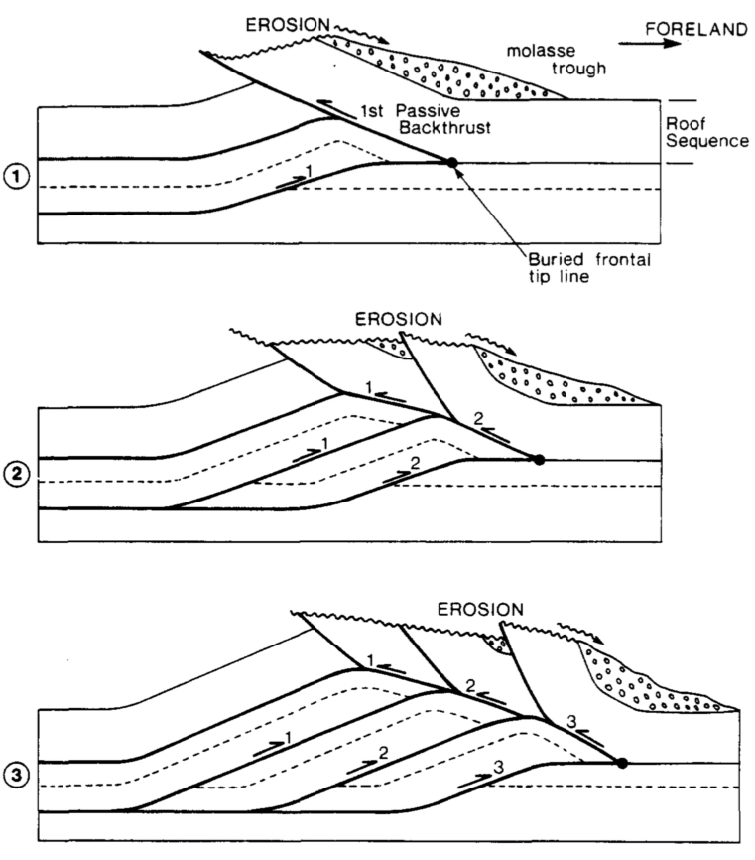
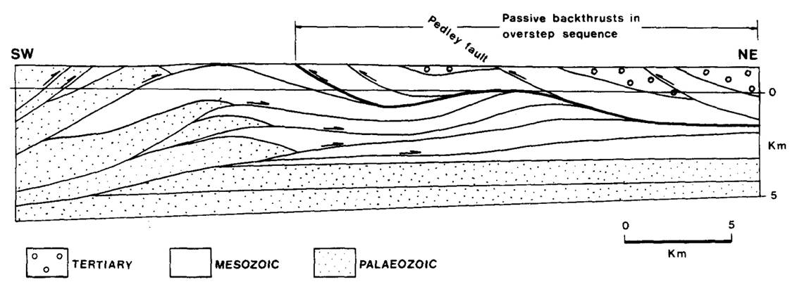
Passive roof duplexes
In circumstances where a duplex underthrusts the foreland so that the overlying units are not themselves displaced laterally, the roof thrust is described as a passive roof thrust, and the duplex as a passive roof duplex
This is effectively a tectonic delamination process
Development of a sequence of passive back-thrusts
An example from the Athabasca Valley foothills, eastern Rocky Mountains
Notes:
On passive roof duplexes, see Banks & Warburton, 1986, Journal of Structural Geology 8: 229-237, https://doi.org/10.1016/0191-8141(86)90045-3. Note that the area under the passive roof thrust that lies above the foreland-propagating sole thrust is a triangle zone. Passive roof duplexes can provide excellent traps in petroleum-rich provinces
Figures from Banks & Warburton, 1986, Journal of Structural Geology 8: 229-237, https://doi.org/10.1016/0191-8141(86)90045-3

Slide 26
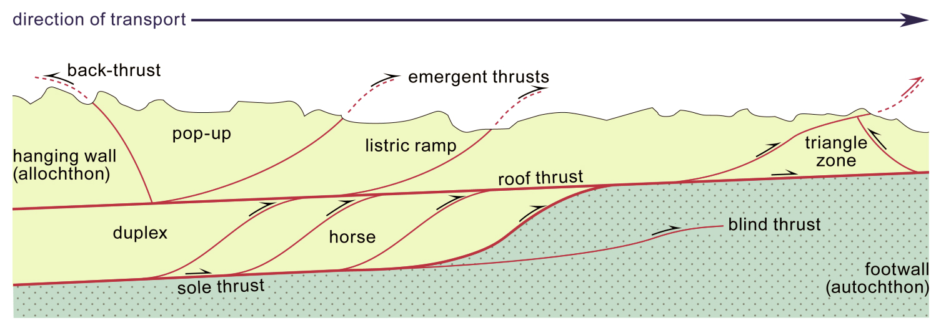
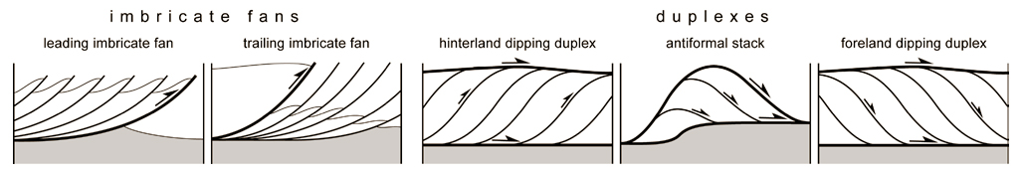
Summary of some of the key terms
Notes:
Figure top from J-P Burg’s 2015 lecture notes (www.files.ethz.ch/structuralgeology/JPB/files/English/4thrustsyst.pdf), p.112
Figure bottom from J-P Burg’s 2015 lecture notes (www.files.ethz.ch/structuralgeology/JPB/files/English/4thrustsyst.pdf), p.114, but ultimately from Boyer & Elliott, p.1200

Slide 27
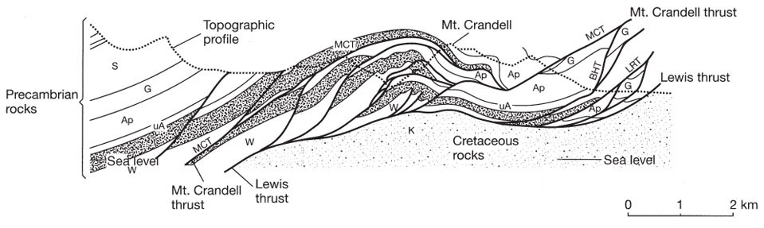
Unravelling sequences
With care, the sequence of thrusting may be determined. In the section shown here of the Waterton oil field (southern Alberta, Canada), the Lewis thrust is the floor thrust and the Mount Crandell thrust the roof thrust to a hinterland-dipping duplex cum antiformal stack
Foreland propagation (here to the right) is implied by the fact that higher thrusts/ horses in the duplex are folded over the ramps and horses in the lower part of the section and so must be earlier
Notes:
Distinguishing whether the sequence of thrusts is a foreland-propagating sequence (generally assumed to be more common) or a break-back sequence (see Slide 20 for an explanation of these terms) is not always easy. For an analysis of criteria that may be used as evidence for a break-back sequence of thrusting, see Alsop et al., 2018, Journal of Structural Geology 109: 99-119, https://doi.org/10.1016/j.jsg.2018.01.005
Figure from Twiss & Moores, p.125, but ultimately from Boyer & Elliott, p.1206 (Boyer & Elliott balance this section – for what I mean by balancing sections, see Slides 49ff.)

Slide 28
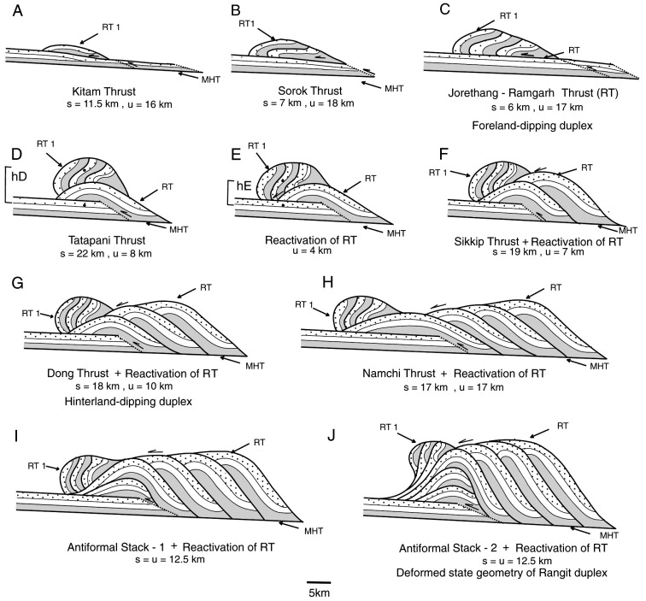
Unravelling sequences 2
In other cases, where horses are squeezed out of position like a pip (far-travelled horses), reconstructing the thrust sequence may be a considerable challenge (perhaps the most difficult mapping challenge there is)
Evolution of the ten horse Rangit duplex, part of the Lesser Himalayan duplex
Notes:
Figure (from Bhattacharyya & Mitra, 2009, Gondwana Research 16: 697-715, https://doi.org/10.1016/j.gr.2009.07.006) showing a model for the kinematic evolution of the Rangit duplex which is exposed in the Darjeeling-Sikkim Himalaya. The development of the Lesser Himalayan duplex, of which the Rangit duplex is a part, is a prominent component in the evolution of the Lesser Himalayan Fold and Thrust Belt

Slide 29
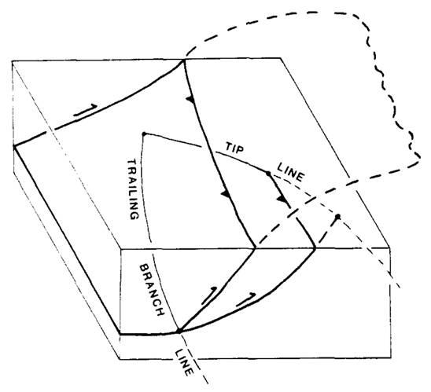



Branch-lines
No cross section though a thrust system should be constructed without considering how the individual faults link up to form three-dimensional networks of faults
Tip-lines: the line marking where fault displacement dies out
Branch-lines: the line marking where a fault splits in two (trailing branch-line) or where two faults merge (leading branch-line)
Cut-off lines: the line marking the intersection of some contact with the fault surface
There are topological constraints on the interrelationship of these lines, and these may be particularly useful in regions with large topography
Simple imbricate splay
Around a horse
Notes:
Note that around a horse a branch-line forms a closed loop with leading and trailing segments; around an imbricate splay, the branch-line connects the ends of the tip-line so that the tip-line can form a closed loop
It is beyond the scope of this class to consider how we may apply the topological constraints noted on this slide – you just need to be aware that such constraints exist. For an account, see Diegel, 1986, Journal of Structural Geology 8: 269-279, https://doi.org/10.1016/0191-8141(86)90048-9
Whenever you map a fault, think about how it connects with other faults to produce a consistent slip displacement story – then you will be well on the way to incorporating these matters intuitively
Figures from Diegel, 1986, Journal of Structural Geology 8: 269-279, https://doi.org/10.1016/0191-8141(86)90048-9

Slide 30
Relationship between folding and faulting

Slide 31

Fault-bend folds
From the moment that a ramp is formed and the hanging wall starts climbing over it, the hanging wall is deformed into a fault-bend fold
The shape of fault-bend folds is determined by the geometry of the ramp because they are geometrically-necessary folds
This means that fold geometry can be predicted from ramp geometry and vice versa
Development of a fault-bend fold. Notice how the hanging wall units are rotated one way and then the other as they climb up and over the ramp
Notes:
The geometric analysis of fault-bend folding has been championed by John Suppe – see Suppe, 1983, American Journal of Science 283: 684-721, https://doi.org/10.2475/ajs.283.7.684
The movie FBFsm.m4v that accompanies this lecture shows the development of fault-bend folds. This comes from Rick Allmendinger’s website, http://www.geo.cornell.edu/geology/faculty/RWA/movies/ OR look in the videos tab at https://www.rickallmendinger.net/)
Figures from Fossen, p.364, 365

Slide 32

Strains during fault-bend folding
The rotation of the hanging wall, first one way and then the other, has implications for the development of strain in the hanging wall rocks
Lower flat: shear coupled with drag on the fault plane leads to cleavage (S₁)
Ramp: cleavage steepens and intensifies
Upper flat: reversal of shear sense in unbending leads to shortening of the cleavage and, in principle, to the development of a crenulation (S₂)
Whether a cleavage (and a crenulation) is observed, depends upon the ramp angle and the mechanical properties/behaviour of the hanging wall rocks
Notes:
I am not aware of actual examples of crenulations that have been interpreted as having being formed in this way, but this does not mean that there aren’t any. A candidate place to look for them would be within relatively incompetent units (mudstones) in interbedded successions
Figure from Sanderson, 1982, Tectonophysics 88: 201-233, https://doi.org/10.1016/0040-1951(82)90237-2. The mechanism of folding is assumed to be flexural flow (with no deformation in the toe of the thrust sheet); other mechanisms of folding (see Class 2) modify the strain variations shown

Slide 33

Fault-propagation folds
Ahead of a thrust tip the deformation is often accommodated in more ductile fashion through the formation of an asymmetric antiform-synform pair that verges towards the foreland. These are described as fault-propagation folds
Fault-propagation folds differ from fault-bend folds in that they move with the propagating fault tip rather than being stationary at the location of the ramp
With some assumptions about layer thickness changes, the fold geometry may be modelled as a function of displacement gradient and fault dip
Progressive development of a fault-propagation fold. Displacement on the fault goes to zero at the tip and continued shortening is accommodated by growth of a fold pair ahead of the tip
Notes:
We noted fault propagation folds and how their development may be modelled in the last class (Class 7 Slides 11-12). Modelling usually proceeds either by assuming predominantly layer parallel slip and the subsequent growth of kink-like folds (as pictured on this slide), or through distributed shearing in a triangular zone ahead of the fault tip (trishear model). Both types of approach are remarkably successful at modelling the geometry of naturally produced folds associated with thrust faults, with kink-like models being better at modelling deformation in systems that have a strong mechanical anisotropy, and trishear models being better when the mechanical anisotropy is less strong (see Hughes & Shaw, 2015, Geological Society of America Bulletin 127: 1752-1765, https://doi.org/10.1130/B31215.1)
Figure from Fossen, p.366

Slide 34

Fault-propagation folds 2
An example of a fault-propagation fold at the termination of the Lewis Thrust, Rocky Mountains
Notes:
Photo (from Fossen, one of the extra figures on the web-site for the book, folk.uib.no/nglhe/StructuralGeoBook.html, but see p.367 of Fossen for a larger panorama): fault-propagation folds at the northern termination of the Lewis Thrust, Mount Kidd, Alberta

Slide 35



Breached fault-propagation folds
Thrusts may breach a fault-propagation fold, usually cutting through the steeply dipping intermediate limb to form a hanging wall antiform and a footwall synform
The space problem arising in the cores of folds may lead to the formation of out-of-the-syncline thrusts, and breaching may be assisted if the main thrust connects with these
Notes:
Photo left (Steve Covey-Crump): hanging wall antiform / footwall synform pair in Lewisian units, Moine Thrust zone near Ullapool, Scotland
Photo right (from the BGS image database: geoscenic.bgs.ac.uk/asset-bank/action/viewHome, image P211445): hanging wall antiform / footwall synform pair on a thrust fault in interbedded Carboniferous sandstones and mudstones, near Broadhaven, St. Brides Bay, Pembrokeshire. This fold is analysed in Williams & Chapman, 1983, Journal of Structural Geology 5: 563-571, https://doi.org/10.1016/0191-8141(83)90068-8
Figure (from Butler, 1982, Journal of Structural Geology 4: 239-245, https://doi.org/10.1016/0191-8141(82)90011-6) showing a fault arising in the core of a fault-propagation synform (an “out-of-the syncline thrust”) – if the ramp segment of the main fault links up with this, the synform is breached. Note that the space problems (too much rock being forced into too small a space) also arise in the cores of antiforms as well as synforms

Slide 36


Breached fault-propagation folds 2
Hanging wall antiform/footwall synform pairs may also arise from
(a) drag
(b) progressive shearing/thinning of the connecting limb
Drag fold
Distinguishing between these two cases and that of breached fault-propagation folds may not always be easy
Sheared connecting limb
Notes:
Photo top (from Fossen, one of the extra figures on the web-site for the book, folk.uib.no/nglhe/StructuralGeoBook.html): Ketobe Knob (San Rafael Swell), Utah. For a panned back view of this fault that shows the offset, see Fossen p.356
Photo bottom (from Fossen, one of the extra figures on the web-site for the book, folk.uib.no/nglhe/StructuralGeoBook.html): Jotun nappe, Norwegian Caledonides

Slide 37



Folds around the margins of thrust sheets
The orientation of folds developed around the margins of a thrust sheet are determined by the orientation of the ramps in the underlying footwall
Over lateral and oblique ramps they form en échelon arrays (the sense of obliquity indicates the transport direction)
Antiformal traces in the Digne nappe, SE France
Notes:
Figure left (from http://www.geol-alp.com/h_verdon/_general_Verdon/general_Barreme.html): the antiformal traces are the thin lenticular black lines; thrust fronts are marked by the lines with teeth; the black arrow indicates the overall transport direction (from the NE)
Figure top right (from www.geol-alp.com/gap_digne/_general_gap_digne/0_nappe_digne.html): en échelon folds forming in a thrust sheet passing over an oblique ramp
Figure bottom right (redrawn by Steve Covey-Crump from Fischer & Coward, 1982, Tectonophysics 88: 291-312, https://doi.org/10.1016/0040-1951(82)90241-4): the changing orientation of fold traces (red lines) in a thrust sheet depending upon whether the underlying ramps are frontal, oblique or lateral

Slide 38



Folds on flats (detachment folds)
Detachment folds form when layers above a décollement shorten more than their substrate (classic example: Jura Mts.)
They tend to be upright and to form over very weak layers (over-pressured mudstones or evaporites)
Analogue models of detachment folds compared with part of the Jura Mountains
Notes:
Figure top left from Fossen, p.367
Figure bottom left (from Price & Cosgrove, p.261): cross section through the Jura Mountains between Blochmontkette and Delsberg (taken from Buxtorf, 1916, Verhandlungen der Naturforschenden Gesellschaft in Basel 27: 184-254, https://www.biodiversitylibrary.org/item/100726#page/1/mode/1up) and below it, detachment folds formed in a wax multilayer. In the Jura Mountains (Alpine foreland) the folded layers are limestones, and the décollement is along evaporites
Photo right (Blay et al., 1977, Journal of the Geological Society, London 133: 329-342, https://doi.org/10.1144/gsjgs.133.4.0329): development of detachment folds in a gelatine multilayer

Slide 39


Detachment folds
If the depth to the detachment ( t₁ ) is known, together with the initial stratigraphic thickness ( t₀ ), then assuming no volume change in the plane of section we can find the amount of shortening ( Δ L ) responsible for the folding by measuring area A_{x} :
A_{x} = A = t₀ Δ L
ΔL
Detachment folds in Holocene glaciofluvial sediments
Notes:
Area methods of this kind are described in detail by Mitra & Namson, 1989, American Journal of Science 289: 563-599, https://doi.org/10.2475/ajs.289.5.563. For comments on the practical difficulties, see Wiltschko & Groshong, 2012, Journal of Structural Geology 41: 7-23, https://doi.org/10.1016/j.jsg.2012.01.019
Figure from Price & Cosgrove, p.166
Photo (from Fossen, one of the extra figures on the web-site for the book, folk.uib.no/nglhe/StructuralGeoBook.html): Etne, south of Bergen, Norway

Slide 40

Folds over antiformal stacks
In thrust systems the fold core may be an antiformal stack. The Oliana antiform is an example, in this case formed in Eocene/Oligocene units in front of the Pyrenean thrust sheets
Notes:
Note that according to this section, the growth of the antiform occurred while some units (those annotated with dots and circles) were being deposited, and that some of these units are cut by thrusts and some are overlying thrusts. Consequently, tight timing constraints on the formation of the structures may be obtained
Figure from Vergés & Muñoz, 1990, Bulletin de la Société Géologique de France 6: 265-271, https://doi.org/10.2113/gssgfbull.VI.2.265

Slide 41




Folds in syntectonic sedimentary sequences
Examining and dating the sedimentary record in units deposited as the structures were forming → natural experiments
Horta, NW Spain
Senez growth fold
Development of the Vélodrome structure during emplacement of the Digne nappe
Notes:
Tight constraints upon when particular structures formed may be obtained by dating the sediments that were deposited as the structure was growing. Similar information may be gleaned by examining, for example, conglomerate clast composition in syntectonic sediments to determine which parts of the mountain belt were being uplifted and eroded at any given time (e.g., Jones et al., 2004, Basin Research 16: 489-506, https://doi.org/10.1111/j.1365-2117.2004.00244.x) – one might expect, because of uplift and erosion of the orogenic belt, that younger conglomerates will contain clasts from deeper (older, more highly metamorphosed) parts of the orogen
Figure top left (adapted by Steve Covey-Crump from http://www.geol-alp.com/gap_digne/_general_gap_digne/0_nappe_digne.html): the development of a basin ahead of a thrust that was subsequently over-ridden by that thrust (the Digne thrust, SE France) as the deformation progressed – this shows the interpretation for the folded units of the Vélodrome, near Digne-les-Bains, SE France (see photo on Class 1 Slide 2 PowerPoint)
Figure bottom left (adapted by Steve Covey-Crump from www.geol-alp.com/gap_digne/_general_gap_digne/barles_demi_fen.html): the end result of the deformation illustrated in the figure immediately above. A photo of the Vélodrome (mountain-scale folds) in the part of the section indicated by the red square is given in Class 1 Slide 2. For a discussion of the evolution of these folds, see Fournier et al., 2008, Bulletin de la Société Géologique de France 179: 551-568, https://doi.org/10.2113/gssgfbull.179.6.551
Photo top right (Steve Covey-Crump): Horta de San Juan, Tarragona, NE Spain. These beds were being progressively tilted as they were being deposited
Photo bottom right (Steve Covey-Crump): growth fold at Senez, near Barrême, France. Note the antiform in the middle of the photo and how the units thicken on the left limb – this limb thickness variation was because the fold was growing as the units were being deposited. The nearly horizontal beds above the fold onlap on to it

Slide 42
Models for fold and thrust belts

Slide 43


Wedge models
Fold and thrust belts show an overall wedge-shaped geometry in cross-section, thinning towards the foreland
Mechanically, such a wedge is analogous to a wedge of sand in front of a moving bulldozer – the sand deforms until it reaches a constant critical taper
The forces applied are (a) push from behind and (b) gravity
The resulting angle of taper (α + β ) depends upon the relative magnitudes of the frictional resistance at the base and the strength of the wedge material
Increasing friction increases the angle of taper (more push is required from behind and so the material piles up higher) – low friction means smaller angles of taper
Increasing wedge material strength decreases the angle of taper (a stronger wedge can be thinner and still slide)
Notes:
The emplacement of large thrust sheets was the subject of a landmark mechanical analysis by Hubbert and Rubey who modelled a thrust sheet as thin rectangular slab (Hubbert & Rubey, 1959, Geological Society of America Bulletin 70: 115-206, https://doi.org/10.1130/0016-7606(1959)70[115:ROFPIM]2.0.CO;2). This analysis emphasized the point that rocks are far too weak for a thin sheet of rock to be pushed over other rocks for 100s km without the sheet deforming internally (it is like trying to push a wet napkin across a tabletop – the napkin will not move as a single rigid unit). Yet thrust sheets that have moved this far are observed. Various ways of resolving this paradox, while retaining the rectangular slab geometry, have been proposed but none are entirely satisfactory (for a discussion see Twiss & Moores, p.258-267). Much greater success has been obtained with the critical wedge model. Details of how thrust sheets may be modelled as wedges are given by Dahlen, 1990, Annual Reviews of Earth and Planetary Sciences 18: 55-99, https://doi.org/10.1146/annurev.ea.18.050190.000415
Figures from Fossen, p.369

Slide 44
Wedge models 2
Assuming friction and strength remain approximately constant, the shape of the wedge is scale invariant – consequently, any process that acts to change the angle of taper during movement must be compensated
As the wedge thickens, the surface slope (α ) increases but so does the basal slope (β ) because the weight of the wedge depresses the lithosphere. The wedge adjusts either by lengthening (imbrication and duplex formation at its toe), or by thinning (gravitational collapse of its surface and/or internal extensional deformation)
As the wedge thins (e.g., by erosion), the surface slope is maintained by uplift through internal shortening (reverse faults, folding)
Such adjustments are accompanied by syntectonic sedimentation (flysch) which redistributes matter on the surface of the wedge so as to maintain a stable surface slope
Notes:
Figure from Fossen, p.369
For an influential model describing these compensating deformation features of thrust wedges as they develop, see Platt, 1986, Geological Society of America Bulletin 97: 1037-1053, https://doi.org/10.1130/0016-7606(1986)97<1037:DOOWAT>2.0.CO;2

Slide 45


The role of gravity
Gravity plays a prominent part in the development of contractional orogenic belts – the dominant driving force?
As an orogenic belt develops, crustal thickening is greatest in the centre of the orogen – if weak enough (perhaps because of heating), this thickened and elevated crust collapses under its own weight, and thrust nappes are pushed out on to the foreland
Different cases may be considered depending upon whether flow is in the direction of surface slope (spreading), or basal slope (gliding) or is an extrusion between constraints
In such gravity-driven deformation one might expect a significant component of pure shear coaxial deformation throughout much of the wedge, the orientation of the strain ellipsoid reflecting the extent of any lateral constraints
Notes:
Note that the gliding model is perhaps only important at local scales since at the regional scale, the basal décollement in active orogenic belts generally dips towards the hinterland (and hence the flow would have to be up-slope). Gliding has similarities with land-slips. At scales of up to a few 10s km, gravitational collapse systems of this kind are called surge zones (see Coward, 1982, Journal of Structural Geology 4: 247-256, https://doi.org/10.1016/0191-8141(82)90012-8)
In contrast, the spreading model allows up-slope flow because it is the surface slope that counts. This has similarities with the flow of glaciers
For a more detailed account of gravity models and their implications for strain history, see Merle, 1989, Tectonophysics 165: 57-71, https://doi.org/10.1016/0040-1951(89)90035-8
Figure left adapted by Steve Covey-Crump from Merle, 1989, Tectonophysics 165: 57-71, https://doi.org/10.1016/0040-1951(89)90035-8
Figure right from Fossen, p.372

Slide 46

Strain through thrust sheets
The relative significance of “push from behind” and gravitational effects is reflected in the distribution of strains through a thrust sheet
Gravity-gliding: thrust sheet does not shorten or lengthen in the slip direction (simple shear)
Push-from-behind: thrust sheet shortens in the slip direction (X is oriented at a steeper angle to the shear plane than in simple shear)
Gravity-spreading: thrust sheet extends (and thins) in the slip direction (X has a sigmoidal variation reflecting the tendency for the surface slope to flatten out to the horizontal)
Orientation of the long axis of the strain ellipsoid (X) through thrust sheets
Such models of strain variation are simplified but may be used as a framework within which to interpret real strain measurements through thrust sheets, and thereby to say something about thrust sheet emplacement mechanisms
Notes:
X on this slide refers to the orientation of the greatest principal strain (the long axis of the strain ellipsoid, see Class 3), e.g., the direction of a stretching lineation
Twiss & Moores (p.675-676) provide a concise discussion of these different models of strain through thrust sheets. Interesting examples of attempts to split strains in thrust sheets into pure shear (shortening or extension) and simple shear components include Coward & Kim, 1981, Geological Society, London, Special Publications 9: 275-292, https://doi.org/10.1144/GSL.SP.1981.009.01.25, and Fischer & Coward, 1982, Tectonophysics 88: 291-312, https://doi.org/10.1016/0040-1951(82)90241-4
Figure (adapted by Steve Covey-Crump from Sanderson, 1982, Tectonophysics 88: 201-233, https://doi.org/10.1016/0040-1951(82)90237-2) showing the orientation of the long axis of the strain ellipsoid through a thrust sheet for the cases of simple shear, simple shear+shortening, and simple shear+extension

Slide 47


Strain through thrust sheets 2
Right: strain variation within the Morcles nappe, Swiss Alps – an example of gravity- glide or possibly gravity-spreading (matters are complicated by an element of extrusion late in the emplacement story)
Left: strain variation within the Bendigo fold and thrust belt, Australia – an example of a push-from-behind case
In this case strain variation through the thrust sheet has been obtained from the fold interlimb angles (ILA) and from the dips of fold axial planes/orientations of the fibres within strain fringes around porphyroblasts (see Class 4)
Notes:
Figure top right from Ramsay & Huber, 1983, The Techniques of Modern Structural Geology, Volume 1: Strain Analysis, p.205
Figure bottom left from Gray & Willman, 1991, Journal of Structural Geology 13: 691-710, https://doi.org/10.1016/0191-8141(91)90031-D. The Bendigo fold and thrust belt is economically important because of the large gold deposits (saddle reefs) that are present in the antiformal hinges

Slide 48

Hinterland perspective
For a complete picture of thrust systems, it is necessary to consider what happens to the sole fault in the hinterland
The sole fault may return to the surface so that horizontal shortening in one part of the crust is balanced by extension in another
The sole fault merges into a high grade metamorphic
root zone of ductile deformation
The ultimate sole fault to a fold and thrust belt is a subduction zone – the thrust belt is a series of splays off a convergent plate boundary fault
Notes:
The shortening observed at the scale of a whole foreland fold and thrust belt is too large for it to be easily paired with an area of comparable extension. Consequently, attractive as it is, Option A probably only applies at smaller scales
Option B replaces thrust-accommodated shortening in the foreland by other processes of shortening in the root zone. In this scenario, it may be that the gravitational collapse of the topographic high created by the shortening and thickening of the root zone drives the subsequent shortening within the fold and thrust belt
Figure from Twiss & Moores, p.129

Slide 49
Section balancing
(fold and thrust belts)
Some additional notes
Notes:
The following slides describe techniques widely used for constructing cross-sections across thrust belts

Slide 50

Techniques for analysing fold and thrust terrains
Several map techniques have been developed to establish the locations of ramps and flats, the sequence of thrust propagation, and other geometric features of thrust systems:
  Stratum contouring of thrust surfaces to produce isopach maps (maps of thrust sheet thickness)
  Branch-line and cut-off line maps
  Stratigraphic separation diagrams
  Hanging wall sequence diagrams
There is no time to consider these techniques in this course unit, but another technique (balanced cross sections) is important to be aware of
The bow-and-arrow rule for estimating thrust movement direction: large thrusts are typically convex towards the movement direction in map view, and as a rule-of-thumb this movement direction is at 90° to the line connecting the two tip points of the thrust
Notes:
Explanations of what techniques 1-4 are, and illustrations of their usefulness, are given in (1) Elliott & Johnson, 1980, Transactions of the Royal Society, Edinburgh (Earth Sciences) 71: 69-96, https://doi.org/10.1017/S0263593300013523, and (2) Coward, 1985, Geological Magazine 122: 595-607, https://doi.org/10.1017/S0016756800032015
Figure from J-P Burg’s 2015 lecture notes (www.files.ethz.ch/structuralgeology/JPB/files/English/4thrustsyst.pdf), p.113

Slide 51

Balanced sections
A balanced cross-section is one that is
  Admissible: the structures that it contains are geologically reasonable with respect to each other and for the tectonic context
  Restorable (retro-deformable): the section can be undeformed (working back in time) such that no significant gaps or overlaps are left
A balanced section may be used to estimate the amount of shortening (or extension)
Zagros fold and thrust belt
All cross-sections should be balanced to check the self-consistency of the interpretation but note that a balanced section is not necessarily a unique solution to the data
Notes:
The basic approach to balancing a section is to start from a point on the foreland that has not been thrusted and to restore the layering to its original length by sequentially removing the displacement on each fault
Figure from Fossen, p.444

Slide 52


Balanced sections: assumptions
In constructing a balanced section, the following initial assumptions are usually made:
  No volume change
  Plane strain (all deformation is in the plane of the section)
  (If the line-length balancing technique is used) all folds are parallel folds formed by flexural slip so that layer thickness is preserved
To some extent these assumptions may be relaxed by more sophisticated 2D- and 3D-balancing techniques (including unstraining the units), although to be properly constrained such techniques may require a formidable amount of extra information
It follows that a balanced section through a thrust system should be constructed parallel to the transport direction
Notes:
Note that if flexural slip is true then there is no strain in the bedding plane – see Class 2 Slides 26-27. This may be tested in the field by examining fossils on bedding surfaces to check that they appear undeformed
A commentary on the assumptions used in balanced section construction is given by Moretti & Callot, 2012, Journal of Structural Geology 41: 64-75, https://doi.org/10.1016/j.jsg.2012.02.014
Figures by Steve Covey-Crump

Slide 53


Initial steps: setting up a template / defining pin-lines
By inspecting the stratigraphy in the foreland ahead of the frontal thrust, draw a template showing the stratigraphic thickness of each layer prior to deformation. This template will usually be a layer-cake but wedge-shaped units can be accommodated if the change of layer thickness with distance along the line of section is known
Define a reference line in the undeformed part of the section (pin-line), and a second line at the other end of the section (loose-line) which you will measure to. The pin-line (a) should be perpendicular to the layering, (b) should transect as much of the stratigraphy as possible, and (c) must not cross a fault. The position of the frontal fault may be added to the template
Notes:
Figures adapted by Steve Covey-Crump from Wilkerson & Dicken, 2001, American Association of Petroleum Geologists Bulletin 85: 1759-1770, https://doi.org/10.1306/8626D063-173B-11D7-8645000102C1865D

Slide 54

Line-length balancing
Measure the length of a stratigraphic marker (e.g., contact between two units) on the original section and add this length to the template. Prior to modern computer drawing packages, measurement was conveniently done with a piece of string. The measurements should be done sequentially within each fault slice, younger to older
Notes:
Figure by Steve Covey-Crump

Slide 55


Line-length balancing – assessing the restoration
The section is admissible if the restored angles between flats and ramps do not exceed ~ 35°, and the restored faults do not cut back on themselves or cut down section
The section is deemed restorable if the loose line in the restored section is straight (a) or smoothly varying (b and c); it is not restorable if it is jagged (d) or stepped (e)
inadmissable section
faults cut back on themselves
Notes:
Methods for evaluating balanced sections in contractional settings are discussed by Wilkerson & Dicken, 2001, American Association of Petroleum Geologists Bulletin 85: 1759-1770, https://doi.org/10.1306/8626D063-173B-11D7-8645000102C1865D
Figure top from Marshak & Woodward, in: Marshak & Mitra, 1988, Basic Methods of Structural Geology, p.303-332 (Fig.14.10)
Figure bottom from Marshak & Woodward, in: Marshak & Mitra, 1988, Basic Methods of Structural Geology, p.303-332 (Fig.14.23)

Slide 56

Area balancing
When layers do not remain constant in thickness the area (A) of a given unit between faults may be measured instead of its length. Since the original thickness ( t₀ ) of the unit is known from the template, then assuming plane strain, the original length ( L₀ ) may be determined from
L₀ = A / t₀
and added to the restoration
Area balancing may be used independently of line-length balancing and so can be used to check line-length restorations
Sections that do not balance need modifying – this may involve changing the ramp angle or adding / removing horses
Notes:
The formula on this slide follows because in plane strain the area (A = L₀t₀) remains constant during shortening
An easy approach to determining the area of a unit on a section is by drawing the section on graph paper and counting the squares that the unit covers. Alternatively, the unit may be cut out from the section (using scissors) and the piece of paper weighed. These days, computer drawing packages generally include a function that calculates areas of objects on diagrams
For comments on area balancing, see Mitra & Namson, 1989, American Journal of Science 289: 563-599, https://doi.org/10.2475/ajs.289.5.563. For area balancing across whole orogenic belts and a consideration of how to interpret the results, see Butler, 2013, Journal of Structural Geology 52: 2-16, https://doi.org/10.1016/j.jsg.2013.03.009
Figure by Steve Covey-Crump

Slide 57
Reading
Fossen H (2016) Structural Geology (2nd edition). Cambridge University Press. [Chapter 17]
Twiss RJ, Moores EM (2007) Structural Geology (2nd edition). WH Freeman and Co. [Chapter 5]
Price NJ, Cosgrove JW (1990) Analysis of Geological Structures. Cambridge University Press. [Chapter 7]
McClay KR (1992) Glossary of thrust tectonics terms. In: McClay KR (ed) Thrust Tectonics, Chapman & Hall, p.419-433
Boyer SE, Elliott D (1982) Thrust systems. American Association of Petroleum Geologists Bulletin 66: 1196-1230, https://doi.org/10.1306/03B5A77D-16D1-11D7-8645000102C1865D
On section balancing
Price NJ, Cosgrove JW (1990) Analysis of Geological Structures. Cambridge University Press. [p.163-167]
Ramsay JG, Huber MI (1987) Techniques of Modern Structural Geology. Volume 2: Folds and Fractures. Academic Press. [Session 24]
Fossen H (2016) Structural Geology (2nd edition). Cambridge University Press. [Chapter 21]

